Slide 1
Foundation of Data Science
Lecture 24 Streaming Algorithm II + Random Walk IV
Reservoir Sampling
Majority Element
k -heavy Element
Mixing Time for Random Walk

Slide 2
Recap Streaming Algorithms
Input is a sequence of items/Can be examined just one pass
Streaming Algorithms:
Made decision before all data available, (may defer!)
Limited working memory !
Online Algorithms :
Made decision before all data available
Taken action immediately

Slide 3
Topics
Probabilistic counting : Morris algorithm
Reservoir sampling
Frequency moments
# of distinct elements
Sketch
Sampling

Slide 4
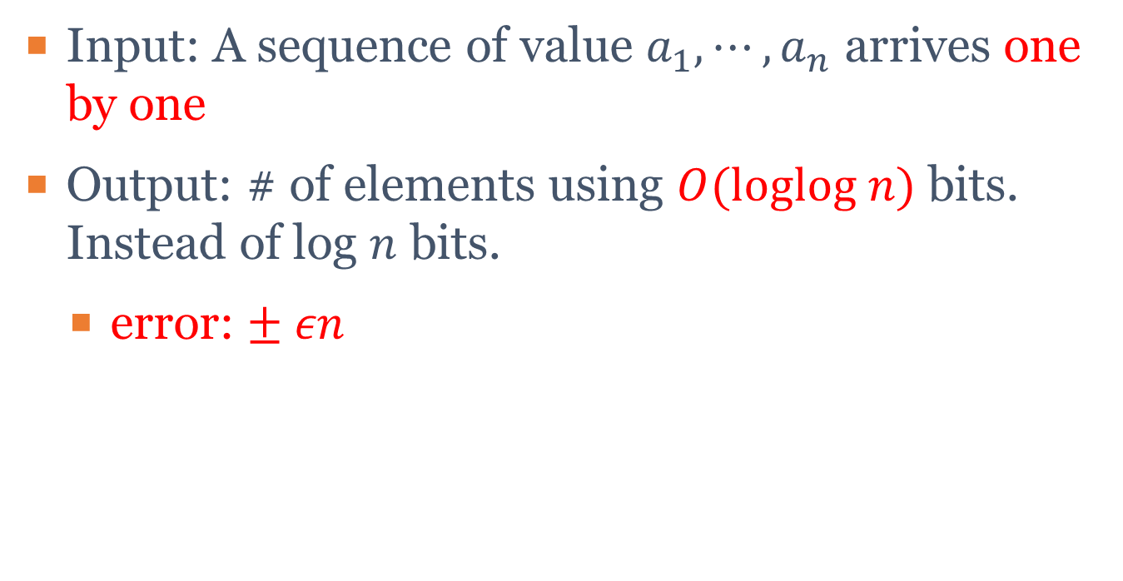
Recap Approximate Counting problem
Input: A sequence of value $a_{1},⋯,a_{n}$ arrives one by one
Output: # of elements using $O(loglog n)$ bits. Instead of log $n$ bits.
error: $± εn$

Slide 5
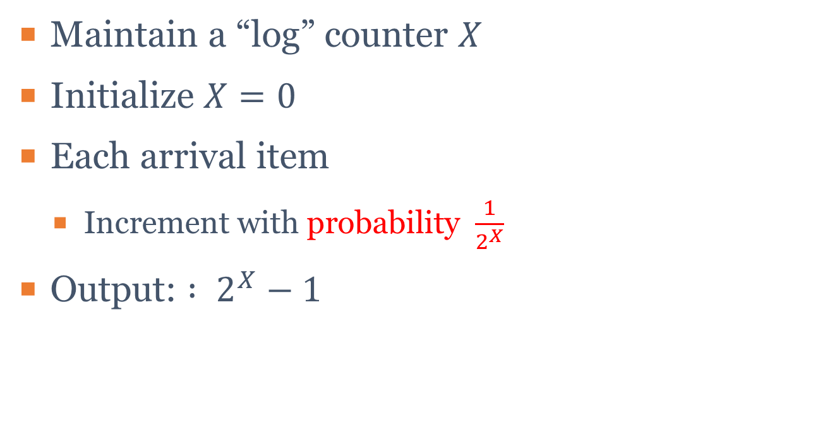
Recap Idea of Morris Algorithm
Maintain a “log” counter $X$
Initialize $X=0$
Each arrival item
Increment with probability $\frac{1}{2^{X}}$
Output: $: 2^{X}−1$

Slide 6
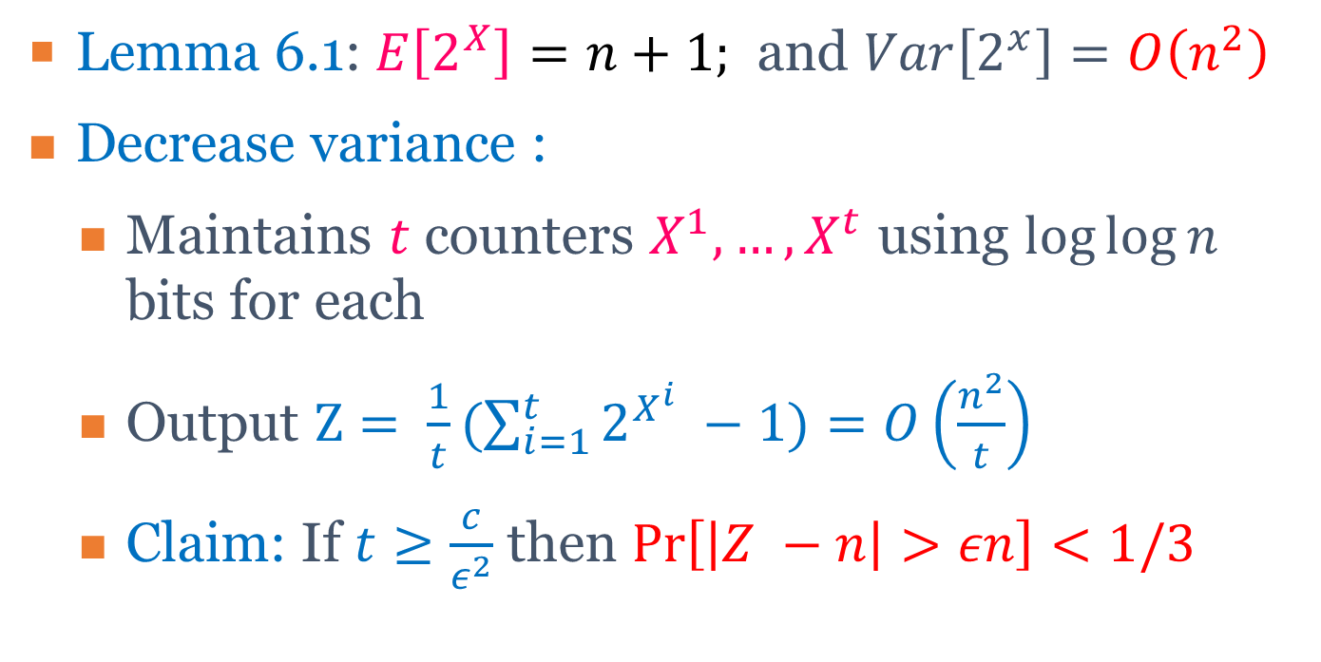
Recap Probabilistic Counting
Lemma 6.1: $E\left[2^{X}\right]=n+1;$ and $Var\left[2^{x}\right]=O\left(n^{2}\right)$
Decrease variance :
Maintains $t$ counters $X^{1}, …,X^{t}$ using $log⁡log⁡n$ bits for each
Output $Z= \frac{1}{t}(\sum_{i=1}^{t}{2^{X^{i}} −1)}=O\left(\frac{n^{2}}{t}\right)$
Claim: If $t≥\frac{c}{ε^{2}}$ then $\operatorname{Pr}\left[\left|Z −n\right|>εn\right]<1/3$

Slide 7
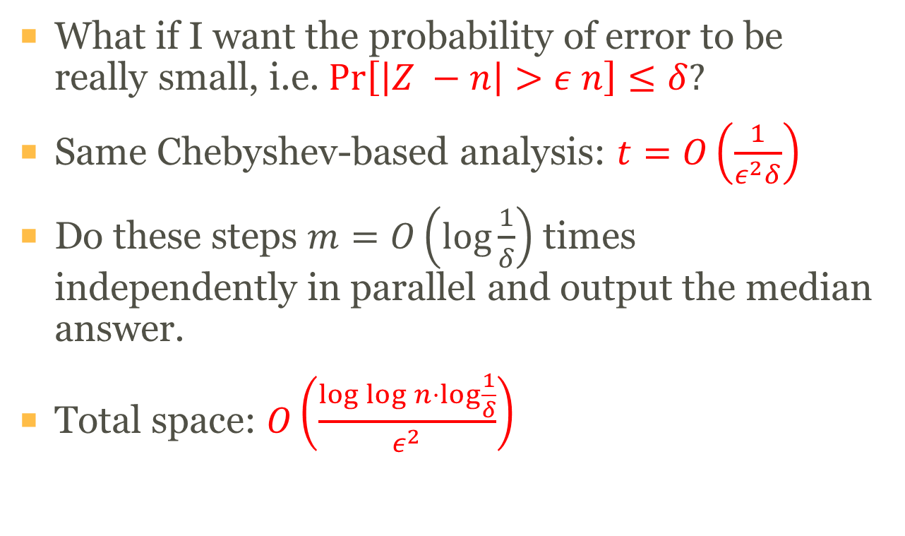
Recap Morris’s Algorithm: Final
What if I want the probability of error to be really small, i.e. $\operatorname{Pr}\left[\left|Z −n\right|>ε n\right]≤δ?$
Same Chebyshev-based analysis: $t=O\left(\frac{1}{ε^{2}δ}\right)$
Do these steps $m=O\left(\log{\frac{1}{δ}}\right)$ times independently in parallel and output the median answer.
Total space: $O\left(\frac{\log{\log{n}}⋅\log{\frac{1}{δ}}}{ε^{2}}\right)$

Slide 8
Foundation of Data Science
Lecture 24 Streaming Algorithm II + Random Walk IV
Reservoir Sampling
Majority Element
k -heavy Element
Mixing Time for Random Walk

Slide 9
Reservoir Sampling of Size One
Problem : Find uniform sample S from a stream if we don’t know number of elements n.
Get a representative sample of a data stream
Do analysis and estimate statistics of the whole stream.
Question : How to sample a stream ?
If we have seen 1000 data, memory can only store 100 elements.
Attempt 1 : every tenth data entry.
Attempt 2 : Generate a random number in [1-10] to skip.

Slide 10
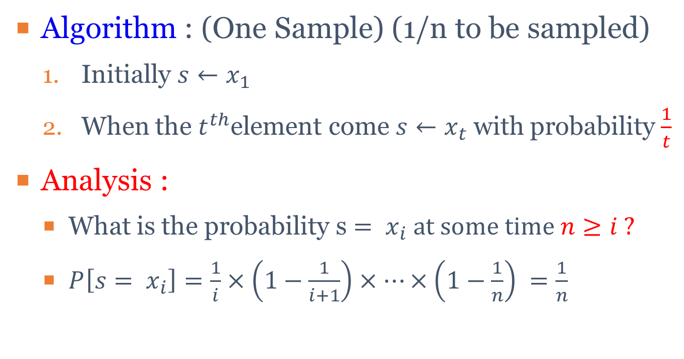
Reservoir Sampling of Size One
Algorithm : (One Sample) (1/n to be sampled)
Initially $s←x_{1}$
When the $t^{th}$element come $s←x_{t}$ with probability$\frac{1}{t}$
Analysis :
What is the probability s $= x_{i} at some time n≥i ?$
$P\left[s= x_{i}\right]=\frac{1}{i}×\left(1−\frac{1}{i+1}\right)×⋯×\left(1−\frac{1}{n}\right) =\frac{1}{n}$

Slide 11
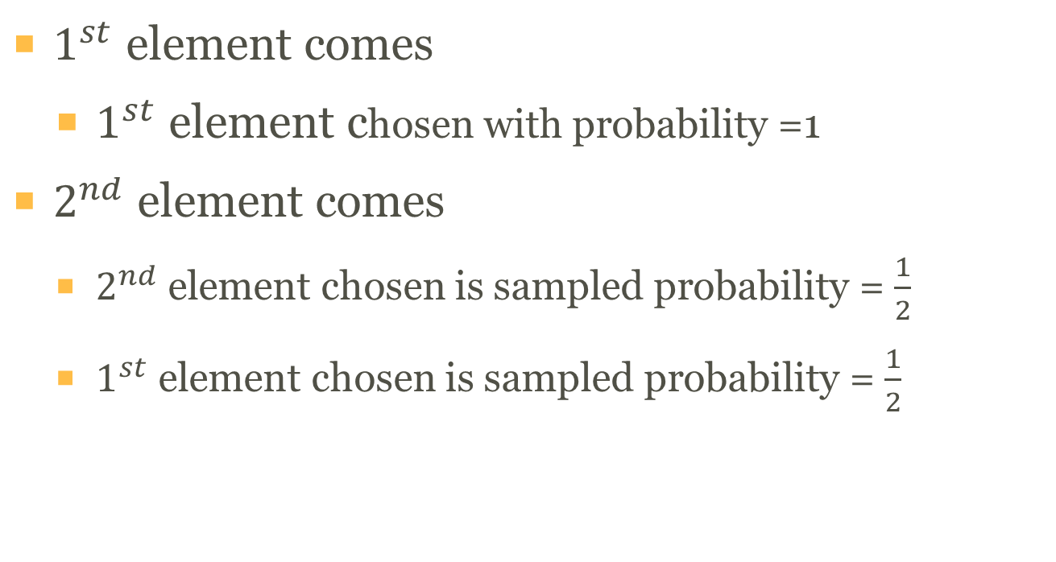
Example for Reservoir Sampling of Size One (I)
$1^{st}$ element comes
$1^{st}$ element chosen with probability =1
$2^{nd}$ element comes
$2^{nd}$ element chosen is sampled probability = $\frac{1}{2}$
$1^{st}$ element chosen is sampled probability = $\frac{1}{2}$

Slide 12
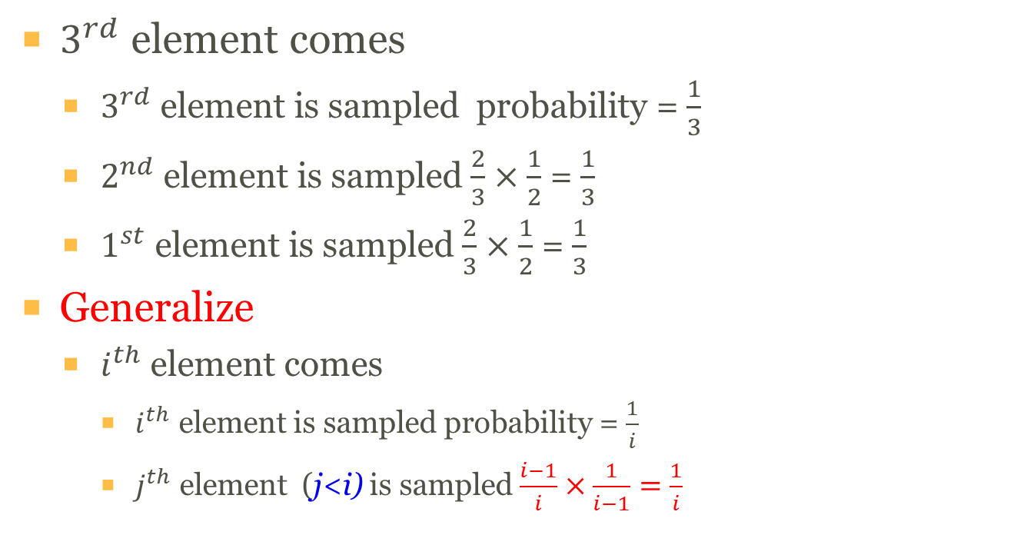
Example for Reservoir Sampling of Size One (II)
$3^{rd}$ element comes
$3^{rd}$ element is sampled probability = $\frac{1}{3}$
$2^{nd}$ element is sampled $\frac{2}{3}×\frac{1}{2}$ = $\frac{1}{3}$
$1^{st}$ element is sampled $\frac{2}{3}×\frac{1}{2}$ = $\frac{1}{3}$
Generalize
$i^{th}$ element comes
$i^{th}$ element is sampled probability = $\frac{1}{i}$
$j^{th}$ element (j<i) is sampled $\frac{i−1}{i}×\frac{1}{i−1}=\frac{1}{i}$

Slide 13
Reservoir Sampling of Size k (I)
With Replacement
Do one sampling algorithm k times in parallel independently
Probability for each element to be selected as sample is : k/n

Slide 14
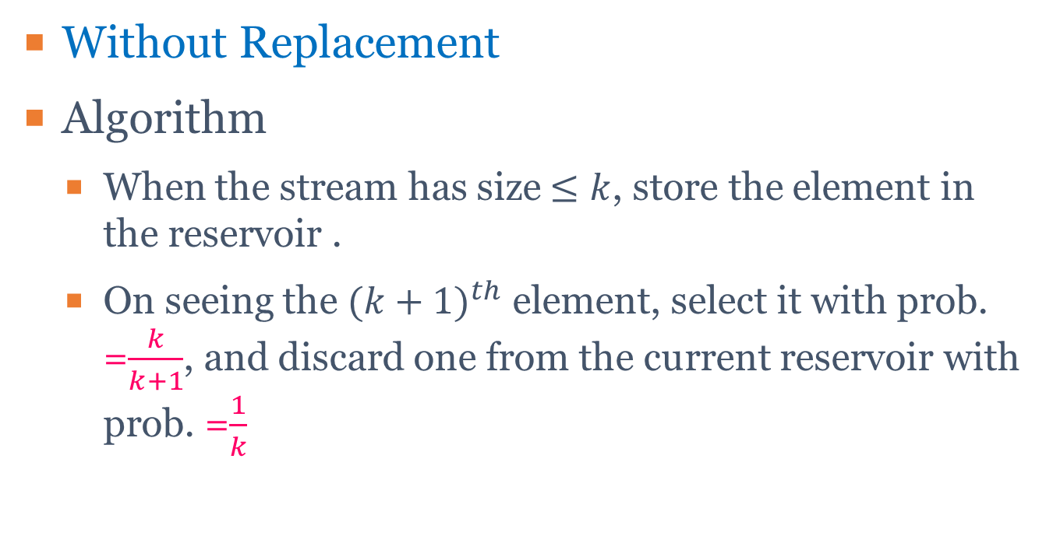
Reservoir Sampling of Size k (II)
Without Replacement
Algorithm
When the stream has size $≤k$, store the element in the reservoir .
On seeing the ${(k+1)}^{th}$ element, select it with prob. =$\frac{k}{k+1}$, and discard one from the current reservoir with prob. =$\frac{1}{k}$

Slide 15
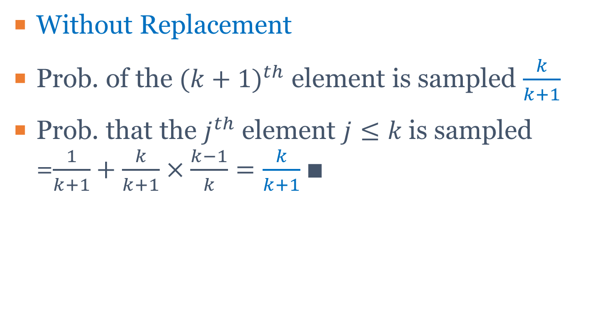
Reservoir Sampling of Size k (III)
Without Replacement
Prob. of the ${(k+1)}^{th}$ element is sampled $\frac{k}{k+1}$
Prob. that the $j^{th}$ element $j≤k$is sampled =$\frac{1}{k+1}+\frac{k}{k+1}×\frac{k−1}{k}=\frac{k}{k+1}∎$

Slide 16
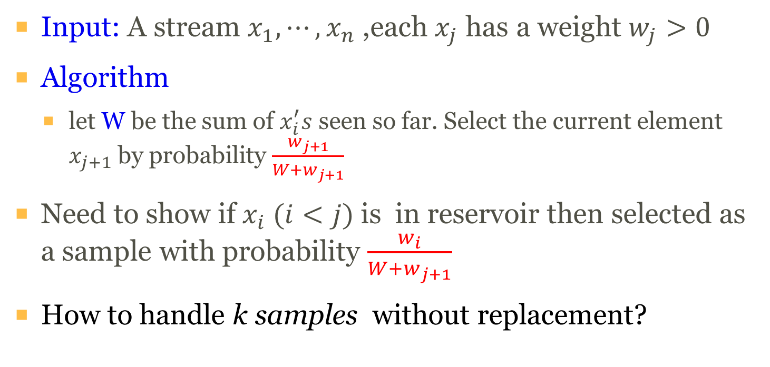
Weighted sampling for One Sample
Input: A stream $x_{1},⋯,x_{n}$ ,each $x_{j}$ has a weight $w_{j}>0$
Algorithm
let W be the sum of $x_{i}^{′}s$ seen so far. Select the current element $x_{j+1}$ by probability $\frac{w_{j+1}}{W+w_{j+1}}$
Need to show if${ x}_{i} (i<j)$is in reservoir then selected as a sample with probability $\frac{w_{i}}{W+w_{j+1}}$
How to handle k samples without replacement?

Slide 17
Foundation of Data Science
Lecture 24 Streaming Algorithm II + Random Walk IV
Reservoir Sampling
Majority Element
k -heavy Element
Mixing Time for Random Walk

Slide 18

Majority Element (I)
Input : stream $a_{1},⋯,a_{n}; a_{i}∈\left[m\right]$
Output : Find a value i appears $≥n/2$ times if it exists

Slide 19
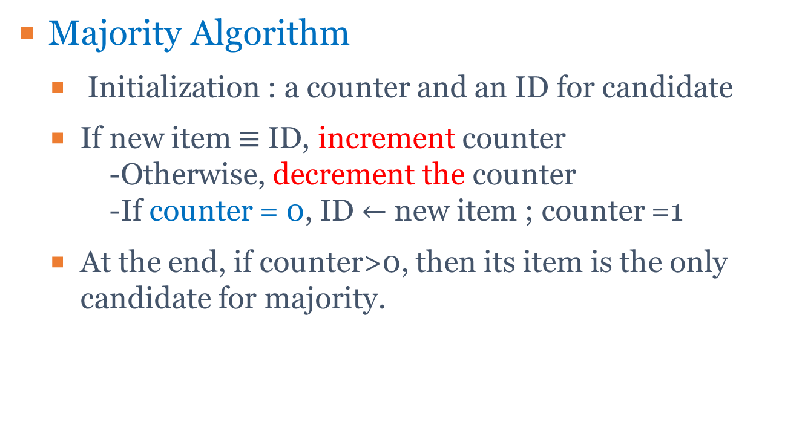
Majority Element (II)
Majority Algorithm
Initialization : a counter and an ID for candidate
If new item$≡$ ID, increment counter -Otherwise, decrement the counter -If counter = 0, ID $←$ new item ; counter =1
At the end, if counter>0, then its item is the only candidate for majority.

Slide 20
Majority Element (III)
Space : $O(\log{n})$ bits
Claim : if there exists a majority element w, then $ID=w$ at the end
*** when a majority does not exist, the algorithm may still return a value. (False Positive)
*** Fact : Can not be done in one-pass to find the majority using sublinear space!

Slide 21
Majority Element (IV)
Example :
Stream | 2 | 9 | 9 | 9 | 7 | 6 | 4 | 9 | 9 | 9 | 3 | 9
ID | 2 | 2 | 9 | 9 | 9 | 9 | 4 | 4 | 9 | 9 | 9 | 9
Counter | 1 | 0 | 1 | 2 | 1 | 0 | 1 | 0 | 1 | 2 | 1 | 2

Slide 22
Foundation of Data Science
Lecture 24 Streaming Algorithm II + Random Walk IV
Reservoir Sampling
Majority Element
k -heavy Element
Mixing Time for Random Walk

Slide 23
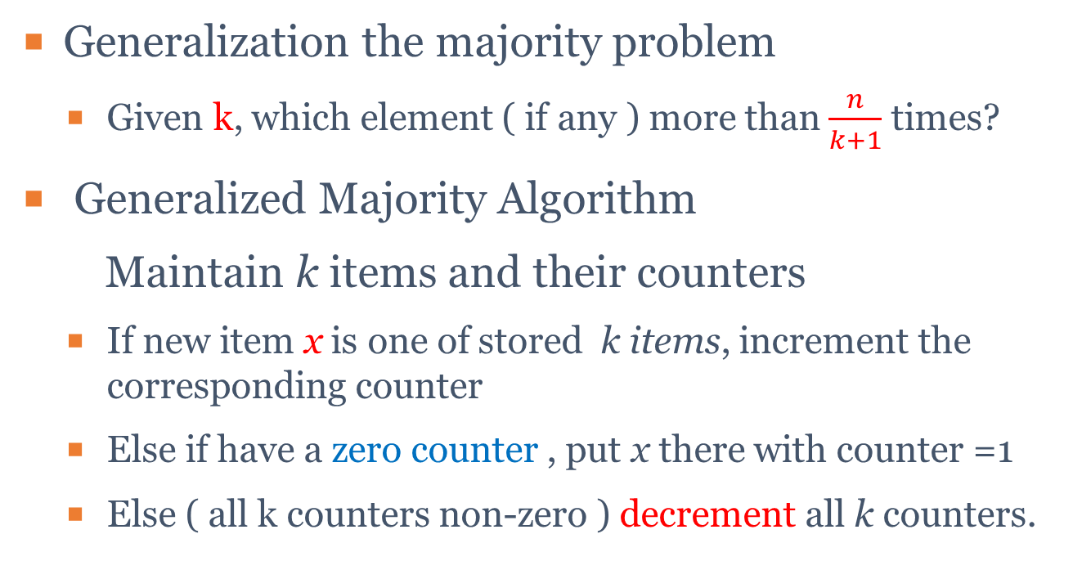
k-Heavy Hitters (I)
Generalization the majority problem
Given k, which element ( if any ) more than $\frac{n}{k+1}$ times?
Generalized Majority Algorithm
Maintain k items and their counters
If new item x is one of stored k items, increment the corresponding counter
Else if have a zero counter , put x there with counter =1
Else ( all k counters non-zero ) decrement all k counters.

Slide 24
k-Heavy Hitters (II)
Example : 32, 12, 14, 32, 7, 12, 32, 7, 6, 12, 4
n= 11, m= 6, k = 3
32, k1=1; k2= 0; k3=0; (7) 32, k1=2;k2=1;k3=0
12, k1=1; k2=1; k3=0; (8) 7, k1=2;k2=1;k3=1
14, k1=1; k2=1; k3=1; (9) 6, k1=1; k2=0; k3=0
32, k1=2;k2=1; k3=1; (10) 12,k1=1; k2=1; k3=0
7, k1=1;k2=0; k3=0; (11) 4, k1=1; k2=1; k3=1
12. k1=1; k2=1; k3=0; Output : 32, 12, 4

Slide 25
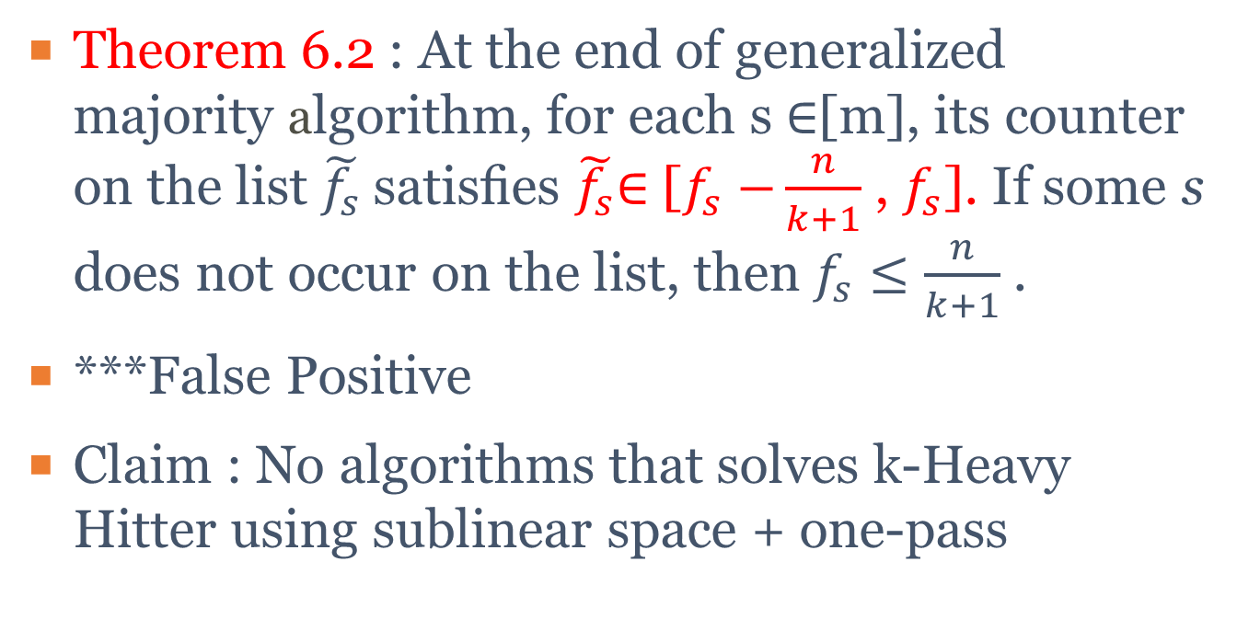
k-Heavy Hitters (III)
Theorem 6.2 : At the end of generalized majority algorithm, for each s ∈[m], its counter on the list $\tilde{f_{s}}$satisﬁes $\tilde{f_{s}}$∈ [$f_{s}$ $−\frac{n}{k+1}$ , $f_{s}$]. If some s does not occur on the list, then $f_{s}≤\frac{n}{k+1}$ .
***False Positive
Claim : No algorithms that solves k-Heavy Hitter using sublinear space + one-pass

Slide 26
Foundation of Data Science
Lecture 24 Streaming Algorithm II + Random Walk IV
Reservoir Sampling
Majority Element
k -heavy Element
Mixing Time for Random Walk

Slide 27
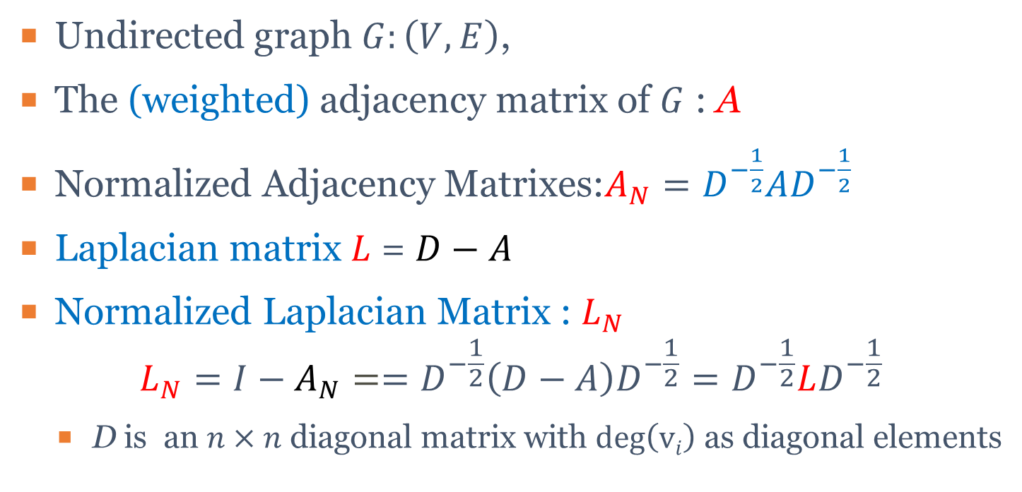
Recap Adjacency/Laplacian Matrix
Undirected graph $G:\left(V,E\right)$,
The (weighted) adjacency matrix of $G$ : A
Normalized Adjacency Matrixes:$A_{N}=D^{−\frac{1}{2}}AD^{−\frac{1}{2}}$
Laplacian matrix $L$ = $D−A$
Normalized Laplacian Matrix : $L_{N}$ $L_{N}=I−A_{N}==D^{−\frac{1}{2}}\left(D−A\right)D^{−\frac{1}{2}}=D^{−\frac{1}{2}}LD^{−\frac{1}{2}}$
D is an $n×n$ diagonal matrix with $\deg\left(vi\right)$ as diagonal elements

Slide 28
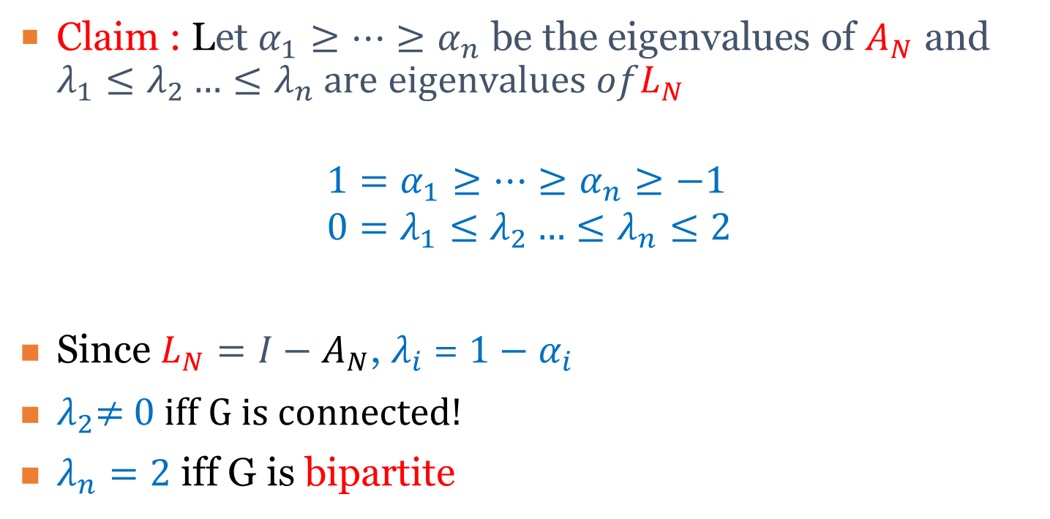

Recap Eigenvalues of $A_{N}$ and $L_{N}$
Claim : Let $α_{1}≥…≥α_{n}$ be the eigenvalues of $A_{N}$ and $λ_{1}≤λ_{2}…≤λ_{n} are eigenvalues ofL_{N}$
$$1=α_{1}≥…≥α_{n}≥−1 \\ 0=λ_{1}≤λ_{2}…≤λ_{n}≤2$$
Since $L_{N}=I−A_{N}$, $λ_{i}$= ${1−α}_{i}$
$λ_{2}$≠ 0 iff G is connected!
$λ_{n}=2$ iff G is bipartite

Slide 29
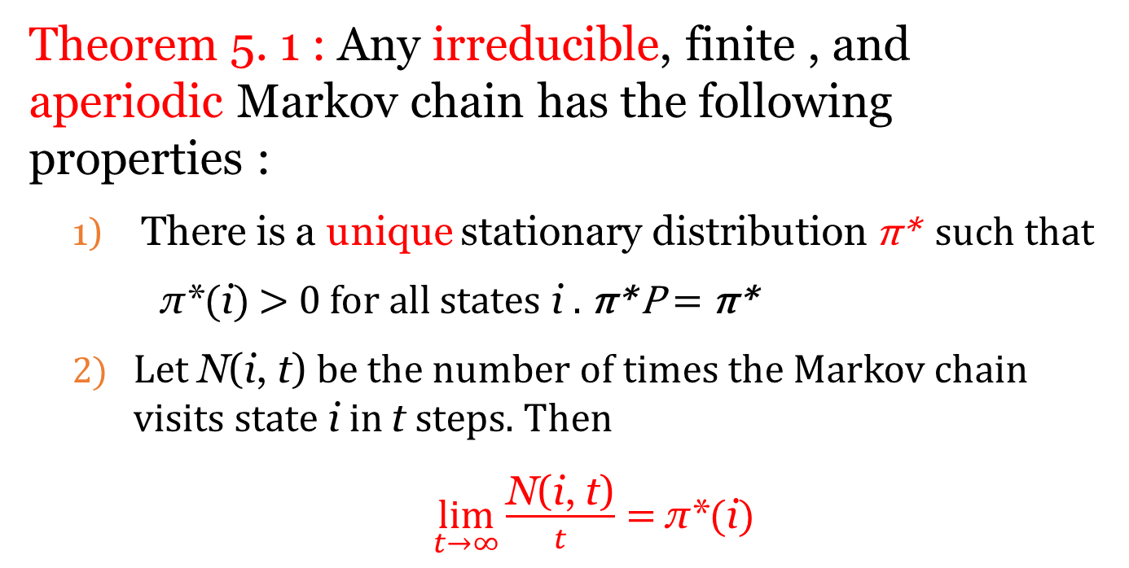
Recap Fundamental Theorem of Markov Chain
Theorem 5. 1 : Any irreducible, finite , and aperiodic Markov chain has the following properties :
There is a unique stationary distribution π* such that
π*(i) > 0 for all states i . π* P = π*
Let N(i, t) be the number of times the Markov chain visits state i in t steps. Then
$\lim_{t→∞}{\frac{\text{N}\text{(}\text{i}\text{, }\text{t}\text{)}}{t}=}$ π*(i)

Slide 30
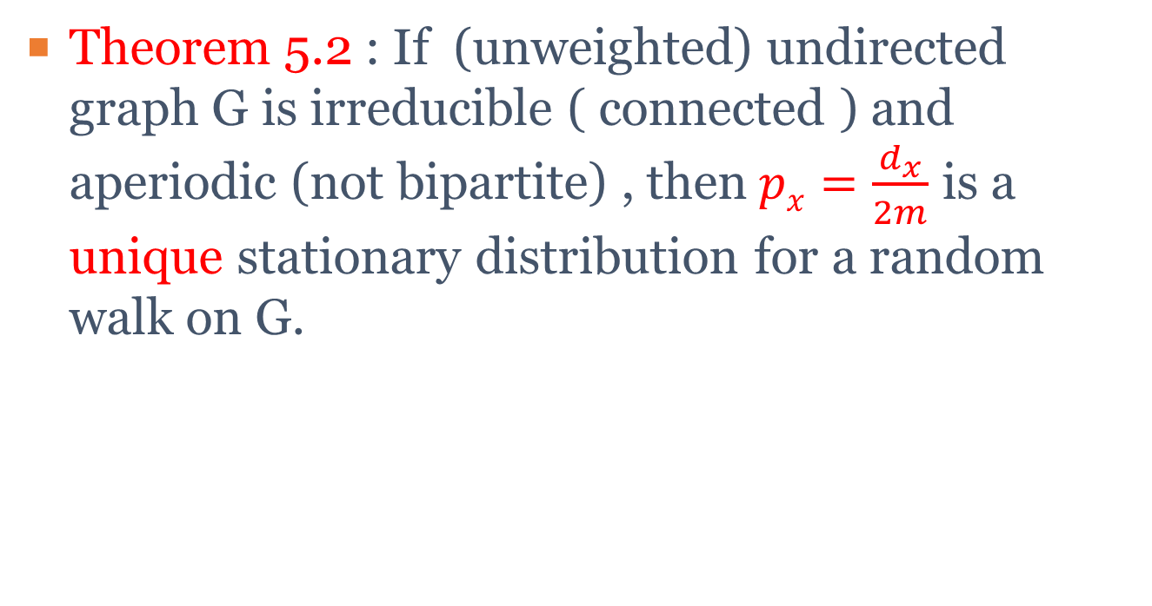
Recap Stationary Distribution on Undirected Graph
Theorem 5.2 : If (unweighted) undirected graph G is irreducible ( connected ) and aperiodic (not bipartite) , then$px=\frac{d_{x}}{2m}$ is a unique stationary distribution for a random walk on G.

Slide 31
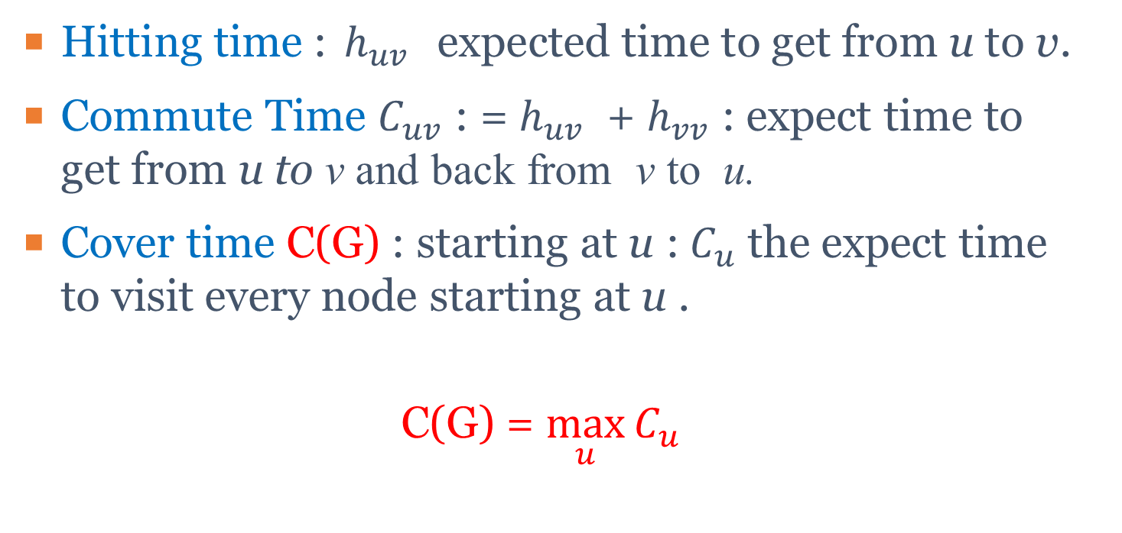
Recap Hitting time and Commute Time
Hitting time : $h_{uv}$ expected time to get from u to v.
Commute Time $C_{uv}$ : = $h_{uv}$ + $h_{vv}$ : expect time to get from u to v and back from v to u.
Cover time C(G) : starting at u :${ C}_{u}$ the expect time to visit every node starting at u .
C(G) = $\max_{u}{C_{u}}$

Slide 32
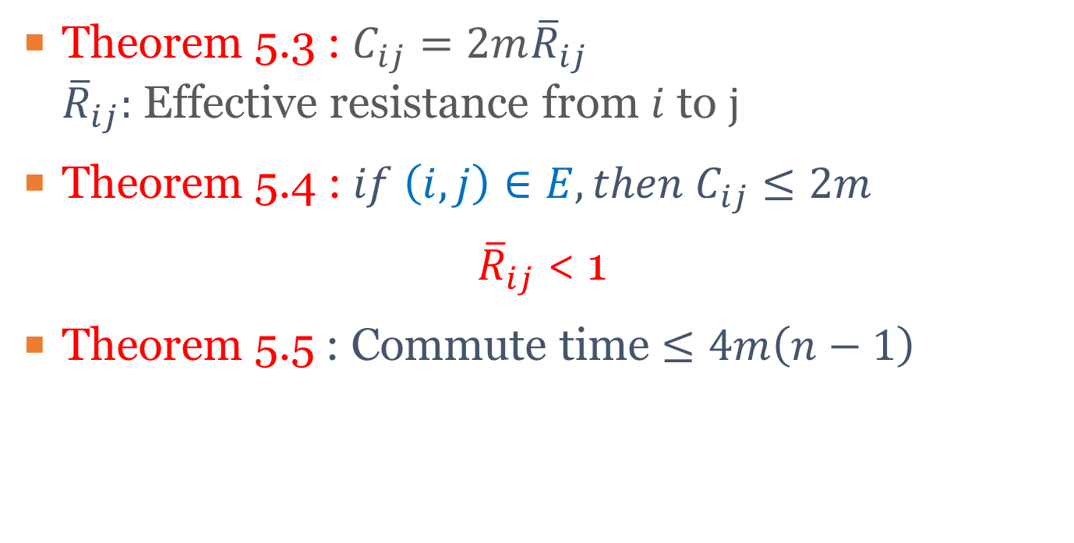
Recap Commute Time
Theorem 5.3 : $C_{ij}=2m{\overline{R}}_{ij}$ ${\overline{R}}_{ij}:$ Effective resistance from $i$ to $j$
Theorem 5.4 : $if \left(i,j\right)∈E, then C_{ij}≤2m$
${\overline{R}}_{ij}$ < 1
Theorem 5.5 : Commute time $≤4m\left(n−1\right)$

Slide 33
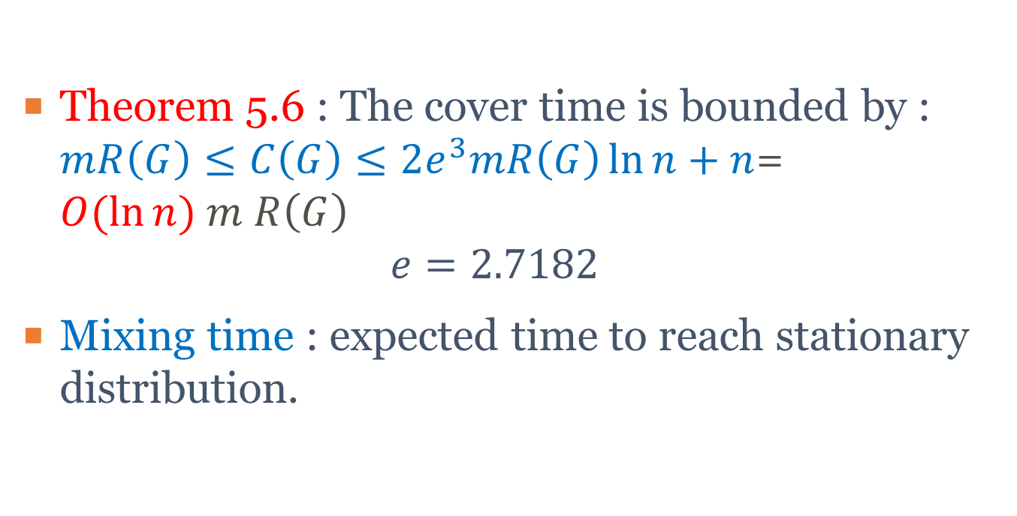
Recap Cover and Mixing Time
Theorem 5.6 : The cover time is bounded by : $mR\left(G\right)≤C\left(G\right)≤2e^{3}mR\left(G\right)\ln{n}+n$= $O(\ln{n}) m R\left(G\right)$ $e=2.7182$
Mixing time : expected time to reach stationary distribution.

Slide 34
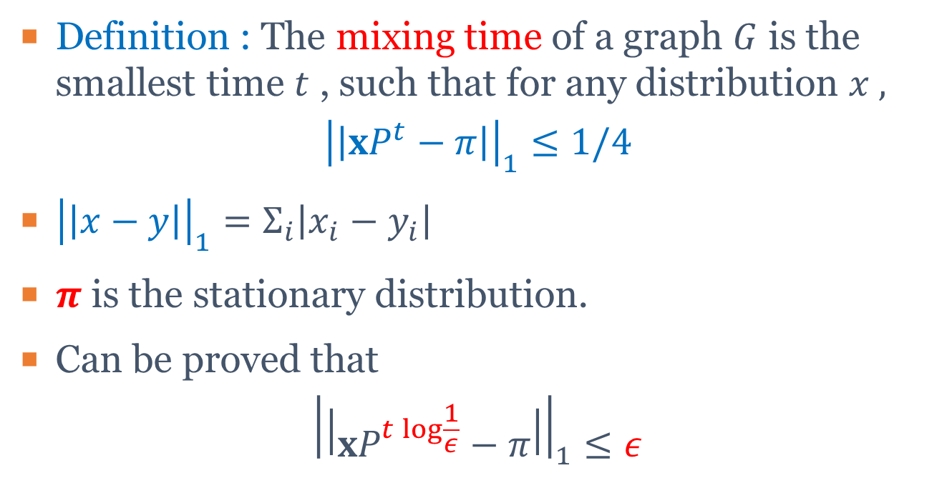
Mixing Time (I)
Definition : The mixing time of a graph $G$ is the smallest time $t$ , such that for any distribution $x ,$
$${\left|\left|xP^{t}−π\right|\right|}_{1}≤1/4$$
${\left|\left|x−y\right|\right|}_{1}=Σ_{i}\left|x_{i}−y_{i}\right|$
$π$ is the stationary distribution.
Can be proved that
$${\left|\left|xP^{t\log{\frac{1}{ε}}}−π\right|\right|}_{1}≤ε$$

Slide 35
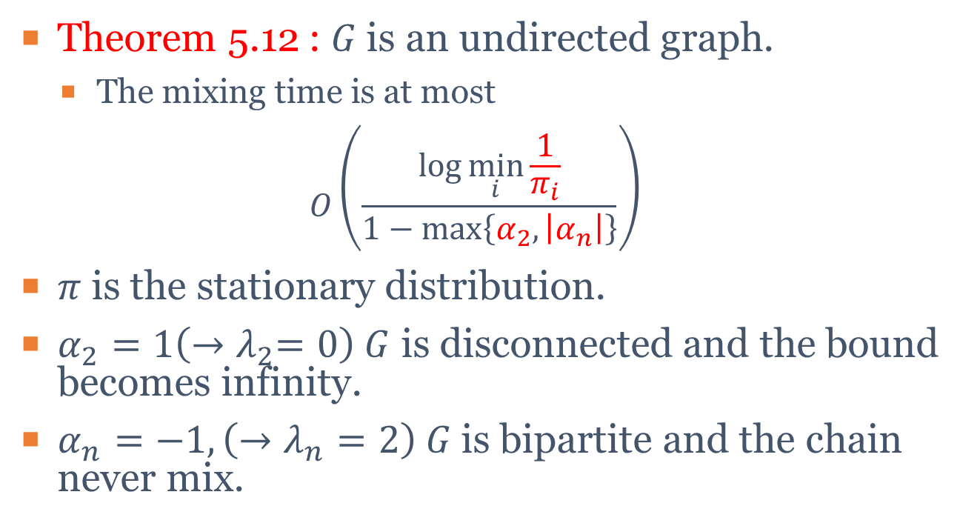
Mixing Time (II)
Theorem 5.12 : $G$is an undirected graph.
The mixing time is at most
$$O\left(\frac{\log{\min_{i}{\frac{1}{π_{i}}}}}{1−\max\left\{α_{2},\left|α_{n}\right|\right\}}\right)$$
$π$ is the stationary distribution.
$α_{2}=1\left({→λ}_{2}=0\right) G$ is disconnected and the bound becomes infinity.
$α_{n}=−1,\left(→λ_{n}=2\right) G$is bipartite and the chain never mix.

Slide 36
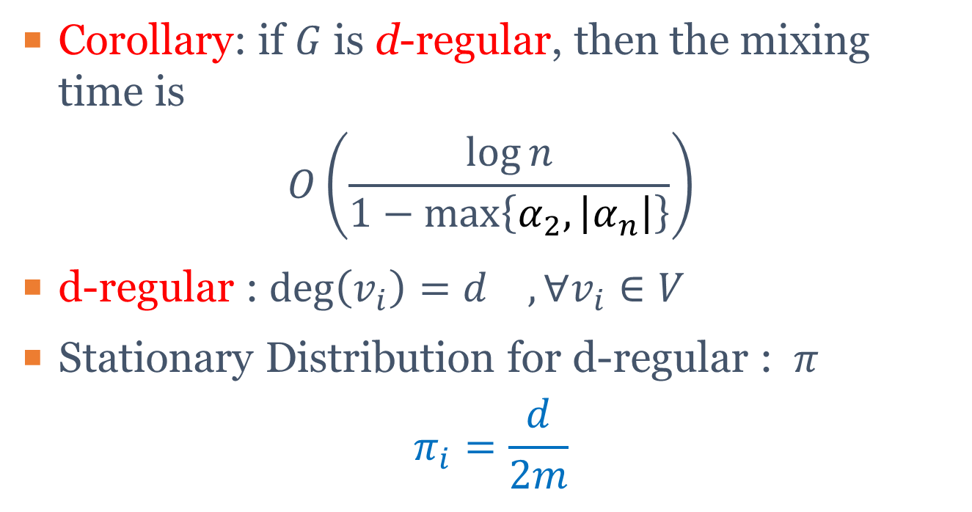
Mixing Time (III)
Corollary: if $G$ is d-regular, then the mixing time is
$$O\left(\frac{\log{n}}{1−\max\left\{α_{2},\left|α_{n}\right|\right\}}\right)$$
d-regular : $\deg\left(v_{i}\right)=d_{} , ∀v_{i}∈V$
Stationary Distribution for d-regular : $π$
$$π_{i}=\frac{d}{2m}$$

Slide 37
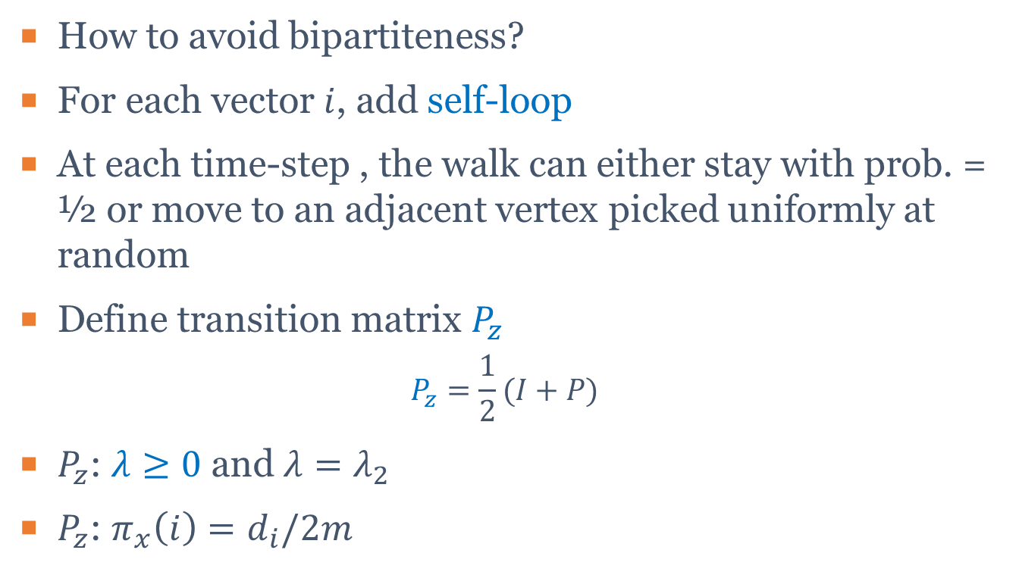
Lazy Random Walk (I)
How to avoid bipartiteness?
For each vector $i$, add self-loop
At each time-step , the walk can either stay with prob. = ½ or move to an adjacent vertex picked uniformly at random
Define transition matrix $P_{z}$
$$P_{z}=\frac{1}{2}(I+P)$$
$P_{z}$: $λ≥0$ and $λ=λ_{2}$
$P_{z}$: $π_{x}\left(i\right)=d_{i}/2m$

Slide 38

Lazy Random Walk (II)
Theorem 5.13 : Let $1=α_{1}≥α_{2}≥…≥α_{n}≥0$ be the eigenvalues of a lazy random walk on $G$. Then the mixing time $O(\frac{\log{\min_{i}{\frac{1}{π_{i}}}}}{1−α_{2}})$

Slide 39
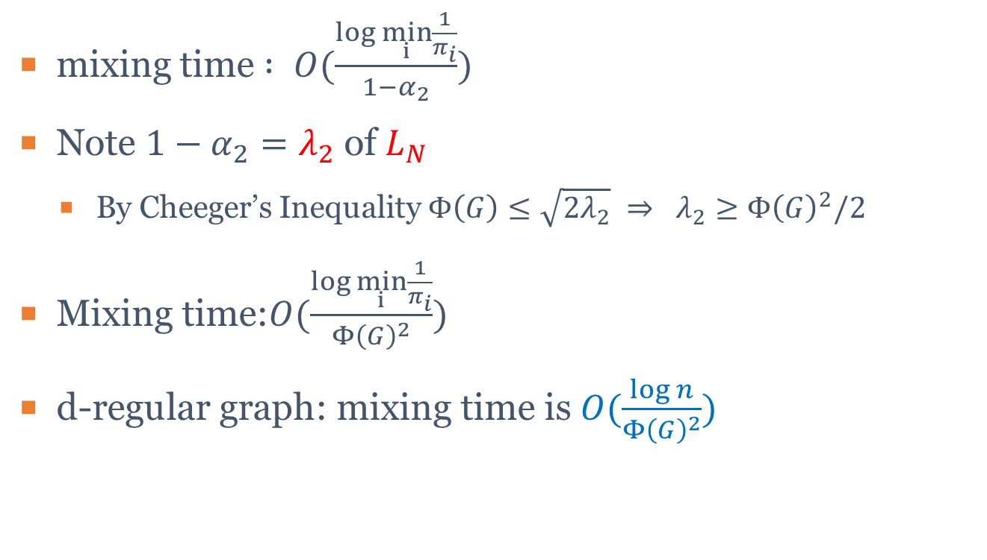
Lazy Random Walk (III)
mixing time $: O(\frac{\log{\min_{i}{\frac{1}{π_{i}}}}}{1−α_{2}})$
Note $1−α_{2}=λ_{2}$ of $L_{N}$
By Cheeger’s Inequality $Φ\left(G\right)≤\sqrt{2λ_{2}} ⇒ λ_{2}≥Φ{\left(G\right)}^{2}/2$
Mixing time:$O(\frac{\log{\min_{i}{\frac{1}{π_{i}}}}}{Φ{\left(G\right)}^{2}})$
d-regular graph: mixing time is $O(\frac{\log{n}}{Φ{\left(G\right)}^{2}})$

Slide 40

Mixing Time for special Graphs
Cycle : $O(n^{2}\log{n})$
$\sqrt{n}×\sqrt{n}$ Grid : $O\left(n\log{n}\right)$
Complete Graph : $O(\log{n})$
Hypercube ($\log_{n}$ regular graph) : $O(\log^{3}{n})$

